Slide 1
Chapter
27
Managerial Accounting
Demo 07: Incremental Analysis (Gold Co.)
Masud Jahan
Department of Science and Humanities
Military Institute of Science and Technology (MIST)

Slide 2
Gold Company’s manufacturing process causes a relatively large number of defective units. The defective units can be (1) sold for scrap, (2) melted down to recover the recycled metal for reuse, or (3) reworked to be good units. If defective units are reworked, the output other good units is reduced because there is no excess capacity. Each unit reworked means one unit cannot be produced. The following information is available about 500 defective units currently on hand:

Slide 3
sales price as scrap | $ 2,500
Additional cost of melting down defective units | 400
cost of purchases avoided by using recycled metal from defects | 4,800
Cost of rework 500 defective units:
Direct materials | 0
Direct labor | 1,500
Incremental overhead | 1,750
Cost of produce 500 new units:
Direct materials | 6,000
Direct labor | 5,000
Incremental overhead | 3,200
Unit sales price of good units | 40

Slide 4
Requirements:
1. Should the company melt down the defective units, sell them as scrap, or rework them?

Slide 5

SOLUTION
Notes:
Learning objective number 1 is to explain the purpose of adjusting entries.

Slide 6
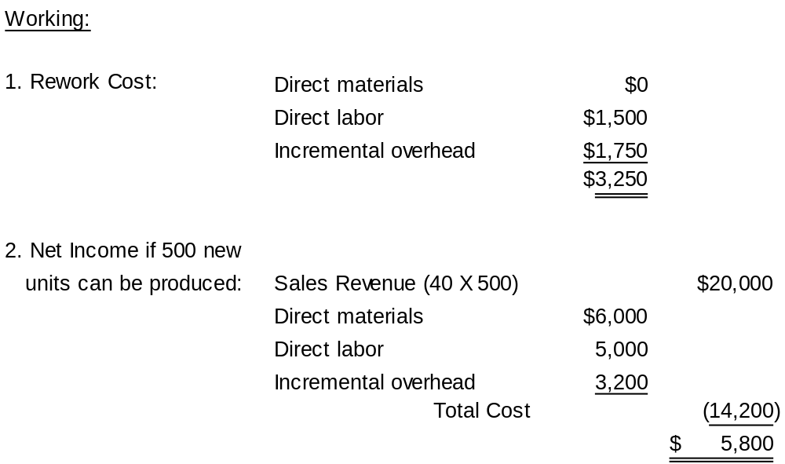
Solution to req. 1

Slide 7
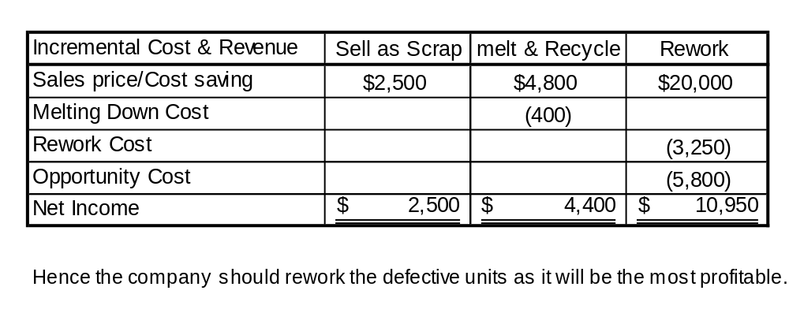
Solution to req. 1

Slide 8
End of Demo 07

